Slide 1
CSE-2202
Design & Analysis of Algorithm
Recurrence Relation

Slide 2
GENERAL RULES FOR ANALYSIS(1/5)
1. Consecutive statements
  Maximum statement is the one counted
    e.g. a fragment with single for-loop followed by double for- loop is O(n²).
Block #1
t₁
t₁+t₂ = max(t₁,t₂)
Block #2
t₂

Slide 3
GENERAL RULES FOR ANALYSIS(2/5)
2. If/Else
if cond then S1
else
S2
Block #1
t₁
Block #2
t₂
Max(t₁,t₂)

Slide 4
GENERAL RULES FOR ANALYSIS(3/5)
3. For Loops
Running time of a for-loop is at most the running time of the statements inside the for-loop times number of iterations
for (i = sum = 0; i < n; i++)
sum += a[i];
for loop iterates n times, executes 2 assignment statements each iteration ==> asymptotic complexity of O(n)

Slide 5
GENERAL RULES FOR ANALYSIS(4/5)
4. Nested For-Loops
Analyze inside-out. Total running time is running time of the statement multiplied by product of the sizes of all the for-loops
e.g. for (i =0; i < n; i++)
for (j = 0, sum = a[0]; j <= i ; j++)
sum += a[j];
  printf("sum for subarray - through %d is %d\n", i, sum);

Slide 6
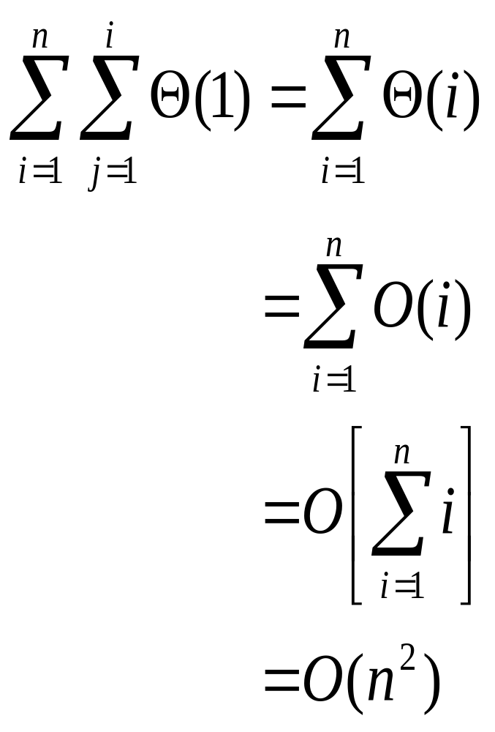
GENERAL RULES FOR ANALYSIS(5/5)

Slide 7
Recurrence Relations (1/2)
A recurrence relation is an equation which is defined in terms of itself.
Why are recurrences good things?
  Many natural functions are easily expressed as recurrences:
    a_{n} = a _{n-1} + 1, a₁ = 1−−> a_{n} = n (polynomial)
    a_{n} = 2a _{n-1} ,a₁ = 1−−> a_{n} = 2^{n} (exponential)
    a_{n} = na _{n-1} ,a₁ = 1−−> a_{n} = n! (weird function)
It is often easy to find a recurrence as the solution of a counting problem

Slide 8
Recurrence Relations (2/2)
In both, we have general and boundary conditions, with the general condition breaking the problem into smaller and smaller pieces.
The initial or boundary condition terminate the recursion.

Slide 9
Recurrence Equations
A recurrence equation defines a function, say T(n). The function is defined recursively, that is, the function T(.) appear in its definition. (recall recursive function call). The recurrence equation should have a base case.
For example:
T(n) = T(n-1)+T(n-2), if n>1
    1, if n=1 or n=0.
base case
for convenience, we sometime write the recurrence equation as:
T(n) = T(n-1)+T(n-2)
T(0) = T(1) = 1.

Slide 10
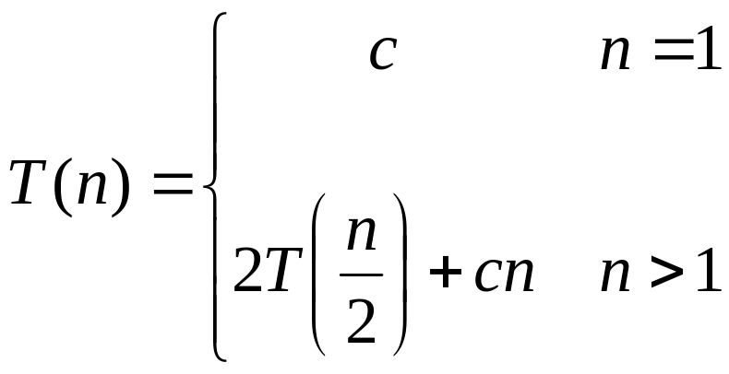
Recurrences
The expression:
is a recurrence.
  Recurrence: an equation that describes a function in terms of its value on smaller functions

Slide 11



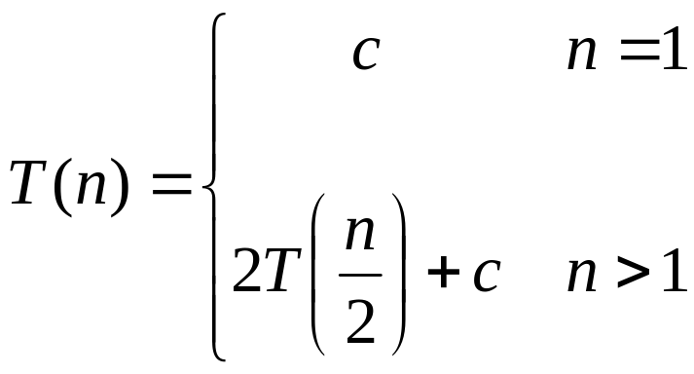
Recurrence Examples

Slide 12
More Recurrence equations:
T(n) = 2 * T(n/2) + 1,
T(1) = 1.
Base case;
initial condition.
T(n) = T(n-1) + n,
T(1) = 1.
Selection Sort
T(n) = 2* T(n/2) + n,
T(1) = 1.
Merge Sort
Quick Sort
T(n) = 2*T(n/2) + log n,
T(1) = 1.
Heap Construction
T(n) = T(n/2) + 1,
T(1) = 0.
Binary search

Slide 13
Methods for Solving Recurrences
Iteration method
Substitution method
Recursion tree method
Master method
Notes:
https://stackoverflow.com/questions/46508578/solving-recurrences-with-iteration-substitution-master-theorem

Slide 14
Simplications:
There are two simplifications we apply that won't affect asymptotic analysis
  ignore floors and ceilings (justification in text)
  assume base cases are constant, i.e., T(n) = Θ(1) for n small enough

Slide 15
Solving Recurrences: Iteration (convert to summation)
Expand the recurrence
Work some algebra to express as a summation
Evaluate the summation

Slide 16
The Iteration Method
T(n) = c + T(n/2)
T(n) = c + T(n/2)
= c + c + T(n/4)
= c + c + c + T(n/8)
Assume n = 2^{k}
T(n) = c + c + … + c + T(1)
= clgn + T(1)
= Θ(lgn)
T(n/2) = c + T(n/4)
T(n/4) = c + T(n/8)
k times

Slide 17

s(n) =
c + s(n-1)
c + c + s(n-2)
2c + s(n-2)
2c + c + s(n-3)
3c + s(n-3)
…
kc + s(n-k) = ck + s(n-k)

Slide 18
So far for n >= k we have
  s(n) = ck + s(n-k)
What if k = n?
  s(n) = cn + s(0) = cn

Slide 19
So far for n >= k we have
  s(n) = ck + s(n-k)
What if k = n?
  s(n) = cn + s(0) = cn
So
Thus in general
  s(n) = cn

Slide 20
Solving Recurrences: Iteration (convert to summation)
Example: T(n) = 4T(n/2) + n
T(n) = 4T(n/2) + n /**expand**/
= 4(n/2 + 4T(n/4)) + n /**simplify**/
= 16T(n/4) + 2n + n /**expand**/
= 16(n/4 + 4T(n/8)) + 2n + n /**simplify**/
= 4²{4T(n/8)+n/4}+(2+1)n
= 4³T(n/2³) + (2²+2¹+2⁰)n
= 4^{k}T(n/2^{k}) + (2^{k-1}+….+2¹+2⁰)n = 4^{k}T(n/2^{k}) + (2^{k}-1)n
Assuming 2^{k}=n,
T(n) = n²T(1) + (n-1)n = n²C+n²-n= Θ(n²)

Slide 21
The substitution method
Guess a solution
Use induction to prove that the solution works

Slide 22
Substitution method
Guess a solution
  T(n) = O(g(n))
  Induction goal: apply the definition of the asymptotic notation
    T(n) ≤ d g(n), for some d > 0 and n ≥ n₀
  Induction hypothesis: T(k) ≤ d g(k) for all k < n
Prove the induction goal
  Use the induction hypothesis to find some values of the constants d and n₀ for which the induction goal holds

Slide 23
Example: Binary Search
T(n) = c + T(n/2)
Guess: T(n) = O(lgn)
  Induction goal: T(n) ≤ d lgn, for some d and n ≥ n₀
  Induction hypothesis: T(n/2) ≤ d lg(n/2)
Proof of induction goal:
T(n) = T(n/2) + c ≤ d lg(n/2) + c
= d lgn – d + c ≤ d lgn
if: – d + c ≤ 0, d ≥ c

Slide 24
Example 2
T(n) = T(n-1) + n
Guess: T(n) = O(n²)
  Induction goal: T(n) ≤ c n², for some c and n ≥ n₀
  Induction hypothesis: T(k-1) ≤ c(k-1)² for all k < n
Proof of induction goal:
T(n) = T(n-1) + n ≤ c (n-1)² + n
= cn² – (2cn – c - n) ≤ cn²
if: 2cn – c – n ≥ 0 ⇔ c ≥ n/(2n-1) ⇔ c ≥ 1/(2 – 1/n)
  For n ≥ 1 ⇒ 2 – 1/n ≥ 1 ⇒ any c ≥ 1 will work

Slide 25
Example 3
T(n) = 2T(n/2) + n
Guess: T(n) = O(nlgn)
  Induction goal: T(n) ≤ cn lgn, for some c and n ≥ n₀
  Induction hypothesis: T(n/2) ≤ cn/2 lg(n/2)
Proof of induction goal:
T(n) = 2T(n/2) + n ≤ 2c (n/2)lg(n/2) + n
= cn lgn – cn + n ≤ cn lgn
if: - cn + n ≤ 0 ⇒ c ≥ 1

Slide 26

Changing variables
T(n) = 2T( ) + lgn
  Rename: m = lgn ⇒ n = 2^{m}
  T (2^{m}) = 2T(2^{m/2}) + m
  Rename: S(m) = T(2^{m})
  S(m) = 2S(m/2) + m ⇒ S(m) = O(mlgm) (demonstrated before)
  T(n) = T(2^{m}) = S(m) = O(mlgm)=O(lgnlglgn)
  Idea: transform the recurrence to one that you have seen before

Slide 27
Evaluate recursive equation using Recursion Tree
Evaluate: T(n) = T(n/2) + T(n/2) + n
  Work copy: T(k) = T(k/2) + T(k/2) + k
  For k=n/2, T(n/2) = T(n/4) + T(n/4) + (n/2)
[size|cost]

Slide 28
Recursion-tree method
A recursion tree models the costs (time) of a recursive execution of an algorithm.
The recursion tree method is good for generating guesses for the substitution method.
The recursion-tree method can be unreliable.
The recursion-tree method promotes intuition, however.

Slide 29
Recursion Tree e.g.
To evaluate the total cost of the recursion tree
  sum all the non-recursive costs of all nodes
  = Sum (rowSum(cost of all nodes at the same depth))
Determine the maximum depth of the recursion tree:
  For our example, at tree depth d
  the size parameter is n/(2^{d})
  the size parameter converging to base case, i.e. case 1
  such that, n/(2^{d}) = 1,
  d = lg(n)
  The rowSum for each row is n
Therefore, the total cost, T(n) = n lg(n)

Slide 30
Example of recursion tree
Solve T(n) = T(n/4) + T(n/2) + n²:

Slide 31
Example of recursion tree
Solve T(n) = T(n/4) + T(n/2) + n²:
T(n)

Slide 32
Example of recursion tree
Solve T(n) = T(n/4) + T(n/2) + n²:
n²
T(n/4)
T(n/2)

Slide 33
Example of recursion tree
Solve T(n) = T(n/4) + T(n/2) + n²:
n²
(n/4)²
(n/2)²
T(n/16)
T(n/8)
T(n/8)
T(n/4)

Slide 34
Example of recursion tree
Solve T(n) = T(n/4) + T(n/2) + n²:
n²
(n/4)²
(n/2)²
(n/16)²
(n/8)²
(n/8)²
(n/4)²
…
Θ(1)

Slide 35

Example of recursion tree
Solve T(n) = T(n/4) + T(n/2) + n²:
n²
(n/4)²
(n/2)²
(n/16)²
(n/8)²
(n/8)²
(n/4)²
…
Θ(1)

Slide 36
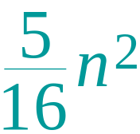
Example of recursion tree
Solve T(n) = T(n/4) + T(n/2) + n²:
n²
(n/4)²
(n/2)²
(n/16)²
(n/8)²
(n/8)²
(n/4)²
…
Θ(1)

Slide 37
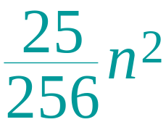
Example of recursion tree
Solve T(n) = T(n/4) + T(n/2) + n²:
n²
(n/4)²
(n/2)²
(n/16)²
(n/8)²
(n/8)²
(n/4)²
…
…
Θ(1)

Slide 38
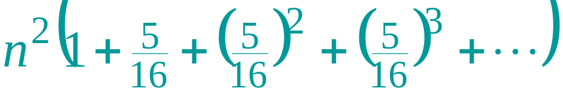
Example of recursion tree
Solve T(n) = T(n/4) + T(n/2) + n²:
n²
(n/4)²
(n/2)²
(n/16)²
(n/8)²
(n/8)²
(n/4)²
…
…
Θ(1)
Total =
= Θ(n²)
geometric series

Slide 39
The Master Method
Based on the Master theorem.
“Cookbook” approach for solving recurrences of the form
  T(n) = aT(n/b) + f(n)
    a ≥ 1, b > 1 are constants.
    f(n) is asymptotically positive.
    n/b may not be an integer, but we ignore floors and ceilings.
Requires memorization of three cases.

Slide 40
The Master Theorem
Theorem 4.1
Let a ≥ 1 and b > 1 be constants, let f(n) be a function, and
Let T(n) be defined on nonnegative integers by the recurrence
T(n) = aT(n/b) + f(n), where we can replace n/b by ⎣n/b⎦ or ⎡n/b⎤.
T(n) can be bounded asymptotically in three cases:
If f(n) = O(n^{logba–ε}) for some constant ε > 0, then T(n) = Θ(n^{logba}).
If f(n) = Θ(n^{logba}), then T(n) = Θ(n^{logba}lg n).
If f(n) = Ω(n^{logba+ε}) for some constant ε > 0,
and if, for some constant c < 1 and all sufficiently large n,
we have a·f(n/b) ≤ c f(n), then T(n) = Θ(f(n)).

Slide 41
Master Method – Examples
T(n) = 16T(n/4)+n
  a = 16, b = 4, n^{logba} = n^{log416} = n².
  f(n) = n = O(n^{logba-ε}) = O(n^{2-ε} ), where ε = 1 ⇒ Case 1.
  Hence, T(n) = Θ(n^{logba} ) = Θ(n²).
T(n) = T(3n/7) + 1
  a = 1, b=7/3, and n^{logba} = n^{log 7/3 1} = n⁰ = 1
  f(n) = 1 = Θ(n^{logba}) ⇒ Case 2.
  Therefore, T(n) = Θ(n^{logba} lg n) = Θ(lg n)
Notes:
This slide explains how to solve recurrence relations using the Master Method, which is a simplified application of the Master Theorem for solving divide-and-conquer recurrences. Let’s break it down step by step.
What is the Master Theorem?
The Master Theorem is used to solve recurrence relations of the form where:
• The number of subproblems at each level.
• The factor by which the input size is divided in each subproblem.
• The cost of work done outside of the recursive calls (e.g., combining results).
The Master Theorem evaluates the growth of relative to (the “critical exponent” term that comes from the recursion tree). The solution depends on comparing with .
Three Cases of the Master Theorem
1. Case 1: grows slower than :
If for some , then:
2. Case 2: grows at the same rate as :
If for some , then:
3. Case 3: grows faster than :
If for some , and if the regularity condition holds (i.e., for some ), then:
Example 1:
Here:
• : 16 subproblems.
• : Input size is divided by 4 at each step.
• : The cost of work outside the recursion.
Step 1: Compute the critical exponent :
So the critical term is .
Step 2: Compare with :
• for (since grows slower than ).
Step 3: Apply Case 1:
Since grows slower than , we conclude:
Example 2:
Here:
• : 1 subproblem.
• : Input size is multiplied by (or divided by ).
• : Constant work outside recursion.
Step 1: Compute the critical exponent :
So the critical term is .
Step 2: Compare with :
• .
Step 3: Apply Case 2:
Since grows at the same rate as , we conclude:
Takeaways
1. Master Method Steps:
• Compute , the critical exponent term.
• Compare with to determine the growth relationship.
• Apply the appropriate case of the Master Theorem to find .

Slide 42
Master Method – Examples
T(n) = 3T(n/4) + n lg n
  a = 3, b=4, thus n^{logba} = n^{log43} = O(n^{0.793})
  f(n) = n lg n = Ω(n^{log43 + ε} ) where ε ≈ 0.2 ⇒ Case 3.
  Therefore, T(n) = Θ(f(n)) = Θ(n lg n).
T(n) = 2T(n/2) + n lg n
  a = 2, b=2, f(n) = n lg n, and n^{logba} = n^{log22} = n
  f(n) is asymptotically larger than n^{logba}, but not polynomially larger. The ratio lg n is asymptotically less than n^{ε} for any positive ε. Thus, the Master Theorem doesn’t apply here.

